Slide 1
STACK

Slide 2
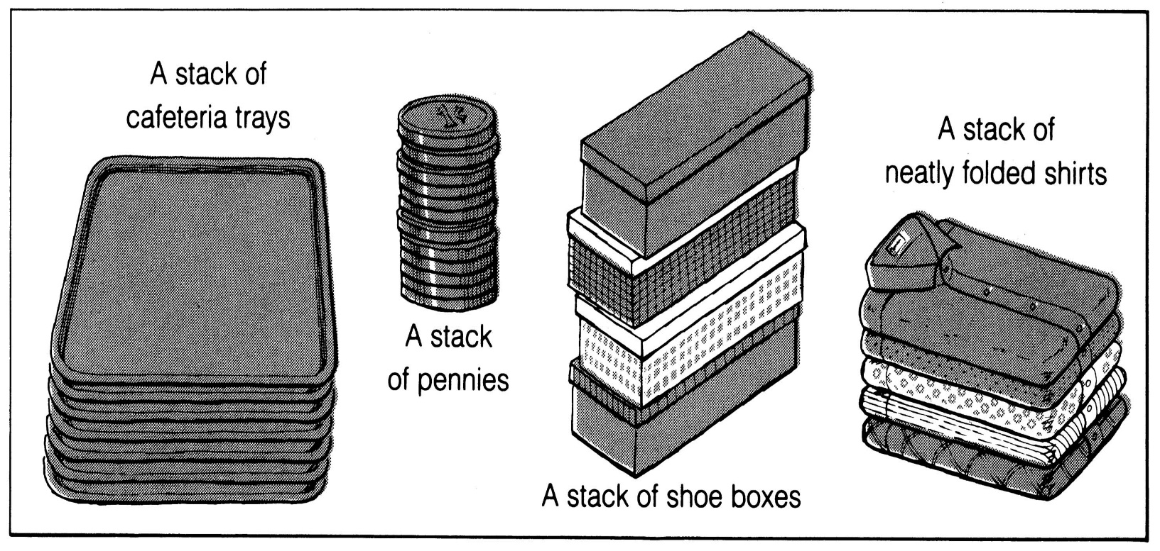
What is a stack?
It is an ordered group of homogeneous items of elements.
Elements are added to and removed from the top of the stack (the most recently added items are at the top of the stack).
The last element to be added is the first to be removed (LIFO: Last In, First Out).

Slide 3
Stack Specification
Definitions: (provided by the user)
MAX_ITEMS: Max number of items that might be on the stack
ItemType: Data type of the items on the stack
Operations
MakeEmpty
Boolean IsEmpty
Boolean IsFull
Push (ItemType newItem)
Pop (ItemType& item) (or pop and top)

Slide 4
Push (ItemType newItem)
Function: Adds newItem to the top of the stack.
Preconditions: Stack has been initialized and is not full.
Postconditions: newItem is at the top of the stack.

Slide 5
Pop (ItemType& item)
Function: Removes topItem from stack and returns it in item.
Preconditions: Stack has been initialized and is not empty.
Postconditions: Top element has been removed from stack and item is a copy of the removed element.

Slide 6
empty
#define MAX 1000
int a[MAX]; //Maximum size of Stack
int top = -1;
bool isEmpty()
{
if(top == -1)
return true;
else
return false;
}}

Slide 7
push
void push(int x)
{
if (top == MAX-1)
{
cout << "Stack full";
}
else
{
top++;
a[top] = x;
}
}

Slide 8
Pop()
void pop()
{
if (isEmpty())
{
cout << "Stack is empty";
}
else
{
top--;
}
}

Slide 9
Display()
void display()
{
if(isEmpty())
{
cout <<"stack is empty";}
else
{
for(int i = 0;i<=top;i++)
cout <<a[i]<<"";
}
}

Slide 10
Main()
int main()
{
push(10);
push(20);
push(30);
push(50);
display();
cout << endl;
pop() ;
pop() ;
display();
return 0;
}

Slide 11
LAB TASK
Write a program to build your own stack class. The minimum your stack class should include is:
A push(Object) method
A pop() method
A peek() method
Test the program using the following procedure: STACK of size N=6
Call PUSH (ITEM)
Call PUSH(ITEM)
Call POP (ITEM)
Display STACK
Display Peak value

Slide 12
Create a simple program to create an stack and to push integer numbers from 1 to 30. Then pop and print on screen the content of the stack.
To print only odd numbers.
To print the top value of stack

Slide 13
A letter means push and an asterisk means pop in the following sequence. Give the sequence of values returned by the pop operations when this sequence of operations is performed on an initially empty LIFO stack.
E A S * Y * Q U E * * * S T * * * I O * N * * *

